Slide 1


PantherSearch

Slide 2

Team Members
דניאל ארמגניאן – 209146943
צחי בקל – 315730176
מתן צוקרמן – 319003935
נדב גולדין – 316350768
אלון טרנרידר – 208635110
שקד עוז – 207475591
אביב בן עזרא - 313596355
PantherSearch

Slide 3
WHAT IS
PantherSearch
The PantherSearch project is a search engine for the redhat website.
Its purpose is to optimize and refine the search on the site on various topics and details, on the subject of cloud computing.
The app consists 2 diffrent screens for regular user and manager user.
PantherSearch

Slide 4



USER
Search
google colab
Chatbot
PantherSearch

Slide 5



Manager
Edit Indexes
Edit Links
A user with administrator privileges can delete
View Statistics
PantherSearch

Slide 6
GUI
Screen
Colab
Each screen is a separate file written in html, js, css.
The screens are displayed in the collab environment with the help of commands to read the files, respectively.
Screens transition
Logo
The transition between the screens is carried out by a suitable function that we have built.
The design and logo were inspired by the team's name - panther.
PantherSearch

Slide 7
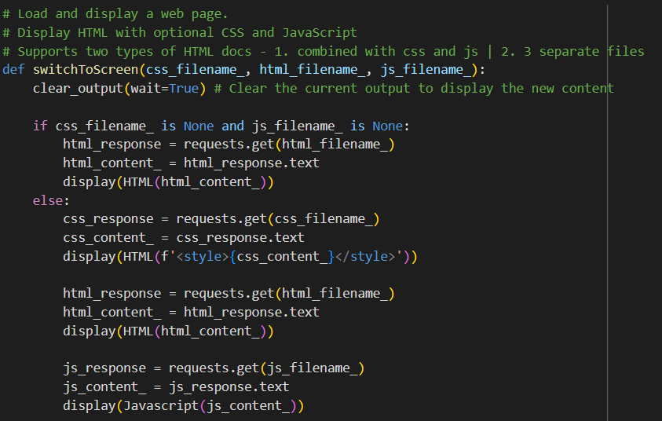
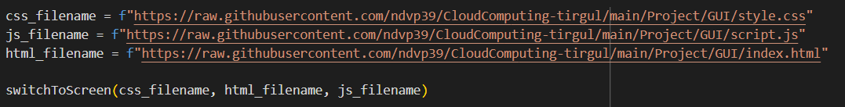
GUI
PantherSearch

Slide 8
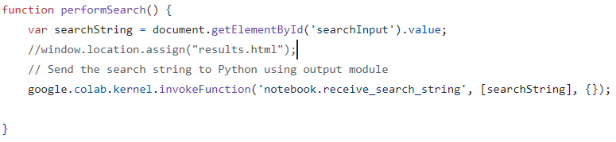

Slide 9

Searching Screen
PantherSearch

Slide 10
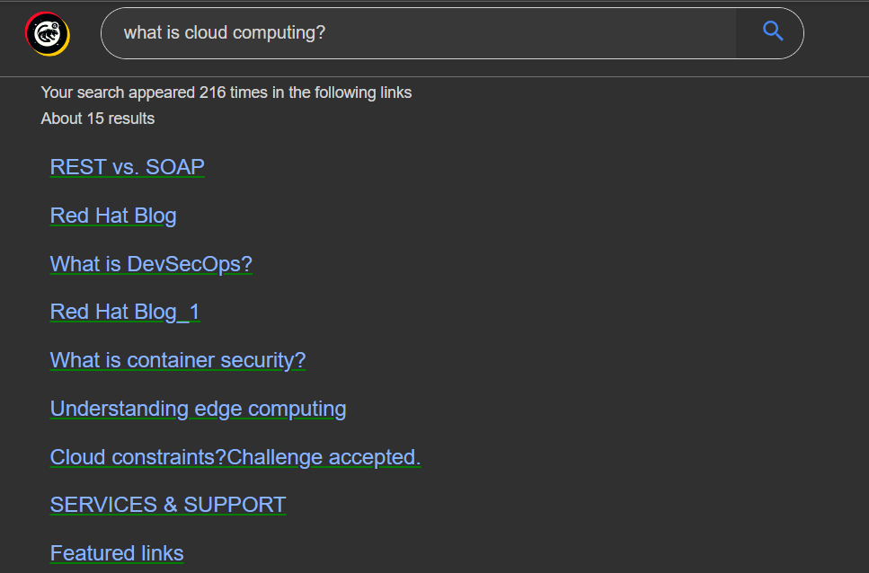
Results Screen
PantherSearch

Slide 11

Chatbot Screen
PantherSearch

Slide 12

Manager Screen
PantherSearch

Slide 13
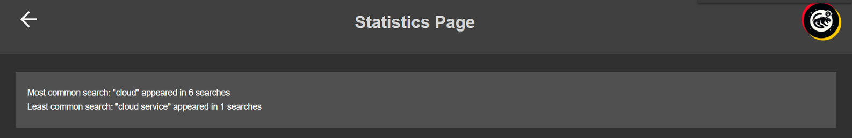
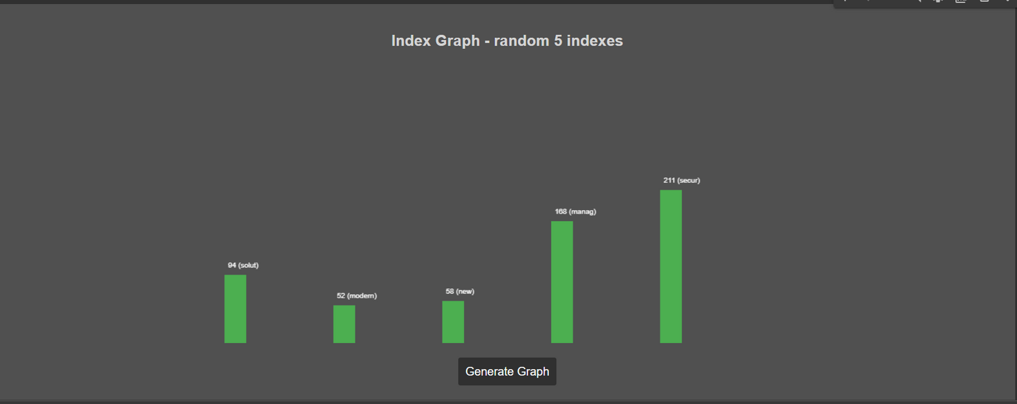
Statistic Screen
PantherSearch
Notes:
הפרויקט על האתר google colab וכשניסנו להתחיל את המימוש היינו נחסמים עוד בתהליך הcrawling, שינינו את האתר ל redhat
בנוסף, כאשר בנינו את הindex בקוד, בנינו אותה בצורה כזאת שהקישורים היו גם מפתחות בתוך map, ואז בגלל הנקודות שהיו בתוך הקישורים לא יכולנו לפתוח real–time database בתוך firebase ולכן עברנו לתוך firestore.
עבודה בצוות גדול, חלוקת משימות נכונה

Slide 14
DataBase
Index Update
When you want to make an update to the index/set of answers, you update the database.
Storage
The index and array of images are stored in the database, each run of the project retrieves them.
Index Creating
chalnge
Creating the index and creating the set of answers for the chatbot are operations that take quite a bit of time, it would not be efficient to do them every run of the project. Therefore using an external database is necessary
At first we chose to use firebase but we ran into problems (it didn't support our index structure), so we switched to firestore.
PantherSearch

Slide 15
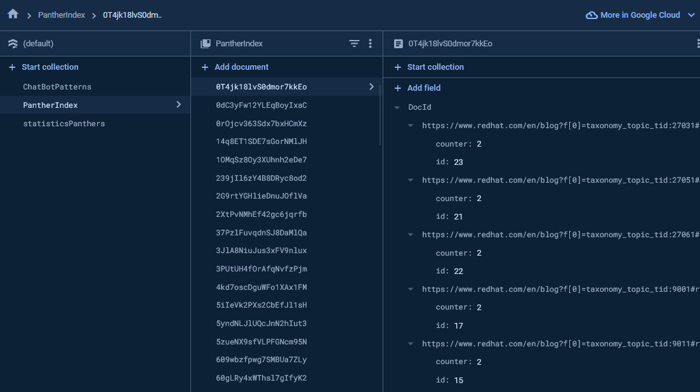
DataBase images
PantherSearch

Slide 16
ChatBot
Optinal Words
We have added all the words from the index to the options of the questions asked
Answers
For each word, we have added as possible answers its links.
Text
After that, we also added relevant text from the link to each link.
PantherSearch

Slide 17
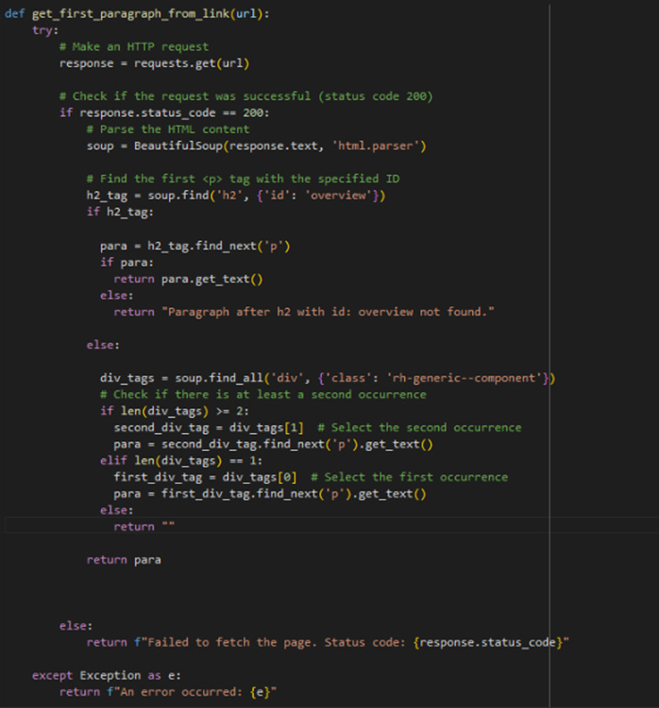
ChatBot
We checked what the general structure of each page in redhat looks like and based on this structure we defined a number of options where we think the answer will be.
The following function does this and returns the answer as text, which we will enter as a possible answer.
PantherSearch

Slide 18
Admin Page
Edit Indexes
Edit Links
A user with administrator privileges can delete
View Statistics
PantherSearch

Slide 19
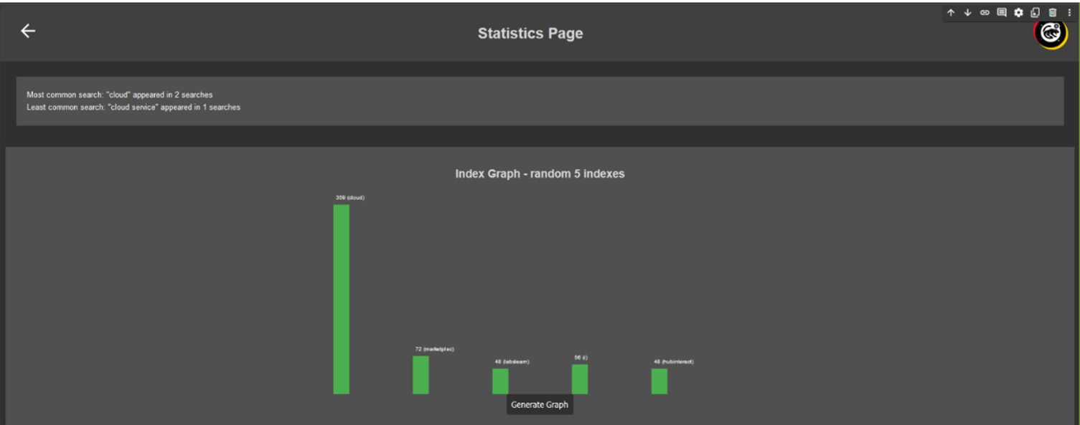
Statistic
We chose to present:
Most common search
Least common search
Visual representation of 5 random indexes
PantherSearch

Slide 20
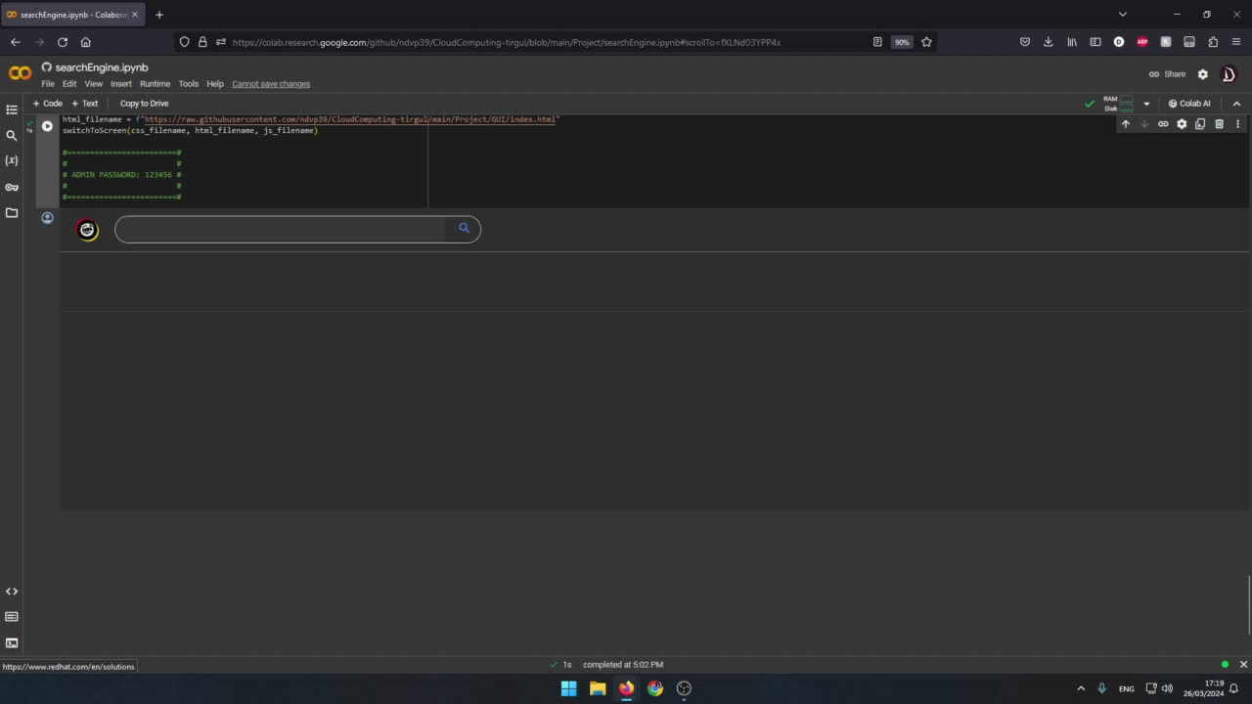
Short Video

Slide 21
Challenges
Crawling in Different Websites
We got blocked while trying to implement crawling on three different websites
Firebase Realtime Database
In realtime database, it was not possible to put a url as a key
Big Group
It can be challenging to work in large groups and divide work properly
PantherSearch
Notes:
בשביל לעשות זחלן- crawling: script שלוקח דאה מהאתר. (בשביל לקרוא את כל התגיות מאתר) על גוגל קולאב ואתר נוסף- לא הצלחנו. (כי דרש להתחבר ופעולות נוספות. )
המידע שלנו מסודר לפי key value. אצלנו בנינו את האינדקס בצורה שבה הקישורים היו key, מה שלא מתאפשר בrealtime database. לכן עברנו לfirestore ששם זה כן מתאפשר

Slide 22




Summary
GUI
SEARCHING
Results
ChatBot
Statistic
Index Editting
PantherSearch

Slide 23
THANK YOU
THANK YOU
THANK YOU
PantherSearch

